Slide 1
Report on Al DUBAi fragrance Brand
By-: Pratik Darandale
-Data Analyst

Slide 2
AGENDA for Report-
Introduction​ to the problem statement
Primary goals
​Report for marketing team
Report for HR Team
​Summary​

Slide 3
Problem statement -
In recent years, Al Dubai Fragrances has faced a certain dip in their revenue and they are now looking to go through a major transformation in the following two sectors.
They are looking to revamp their marketing strategy by targeting the right set of customers.
They are looking to promote their application among customers so that they may enter into the “E-Commerce” sector.

Slide 4
Primary goals -
1 -: Helping the marketing team to Analyze the Customers to target the best and the worst
performing customer to get idea about the market and customer requirement that
can help grow company more and can target the good customer. For this analysis we are
using Excel
2 -: For HR department with the help the data available with us we can now get a perfect view about the AL Dubai Fragrance Brand company to understand the behavior about their company behavior .For analysis we are using SQL .

Slide 5
Firstly We have Focused on marketing team report -
For this marketing team report we have used Excel for better calculation purpose and better insights from data .
There are many problem statements are coming out from this data so we have gone through each questions and come with the solutions.
So from the next slide we are going to see the each problem and their solutions one by one .

Slide 6
For the marketing team report firstly we have have to find the RFM Score from the given dataset –
For the RFM Score method firstly we have to find the for recency, frequency, and monetary value from the dataset .
Recency:- It’s the number of days since the customers has made the last purchase. You may derive the same by subtracting the current date from the last purchase date. Lower the value, the better the customer.
Frequency:- It’s the number of transactions made by a particular customer. Higher the value, the better the customer
Monetary: It’s the total amount spent by a customer in making various purchases. Higher the value, the better the customer.

Slide 7
In order to generate RFM Score, we will first be generating the individual scores from each the columns .
For the Recency column we have Subtracted the last transaction date from the today date by TODAY Function.
For the Frequency Column we have calculated for count of TRANSACTION that customer has done.
For Monetary column have taken the total sales of that particular customer.
After finding RFM Then on that columns we have applied the VLOOKUP formula for the RFM Score between 1 to 5.
The higher the score, the better the customer, the lower the score, the worst the customer.
Then we have got the actual idea about the TOP performing customers and the WORST Performing customers .

Slide 8
Top Performing customers by RFM Score
These are the Top perfoming customers according to the RFM score That Scales between 4.5 to 5 .

Slide 9
Worst Performing Customers
These are the Worst Performing Customers that scales between 0 to 2

Slide 10
The proportion of males and females

Slide 11
The average sales

Slide 12
the number of app and non-app users.

Slide 13
the number of customers and the average number of transactions under each sales level.
For the the number of customers and the average number of transactions under each sales level the column name sales level has added to data
The column sales level need calculation in the L1, L2,L3,L4 & L5 format for the better insight from data .
For the VLOOKUP has used to get all this values .
The next slide shows the actual data in charts .

Slide 14
the number of customers and the average number of transactions under each sales level.

Slide 15
Calculated the data in the category and the number of transactions ranges shown in below table
A | 1-10
B | 10-50
C | 50-100
D | >100
Using v-lookup have appended the category column to the data
Then calculated the Transaction Range for the better insights.
Then have performed the task on that column .

Slide 16
the category-wise count of orders placed.

Slide 17
The top 5 customers according to the percentage of total sales
Using Pivot Table this insight is generated.

Slide 18
Report for hr team -:
In this HR report the dataset is on the Employee and their personal information.
That can help the HR team for better decision making data
For that the tool used is SQL that can give us better results from data.
For this purpose three dataset is used are department data, employees data, locations data .
This Insight is very usefull for the hr department that can give us the actual employee problem and their solutions .

Slide 19
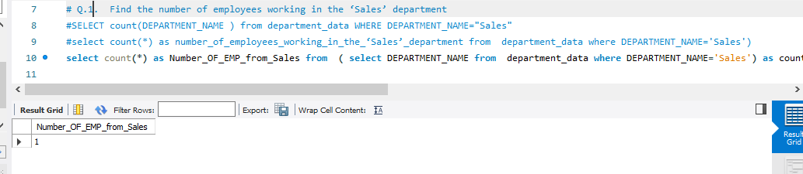
The number of employees working in the ‘Sales’ department
From this output shows that there is only 1 Employee from sales department .

Slide 20
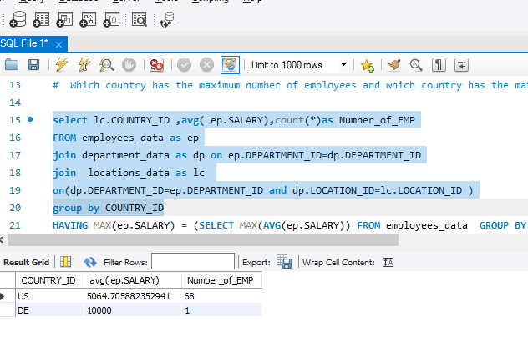
The country-id wise count of employees and the avg salary and the maximum number of employees
For this result 3 tables has joined and result shows there are 2 country and there employee number and avg salary is shown .

Slide 21
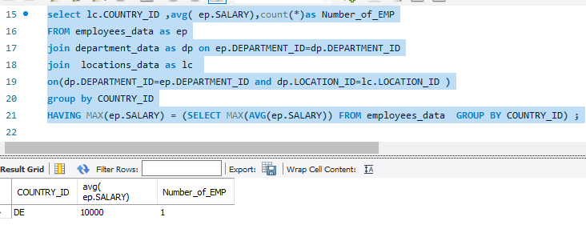
which country has the maximum average salary?
This shows that there is only one country name DE shows maximum average salary .

Slide 22
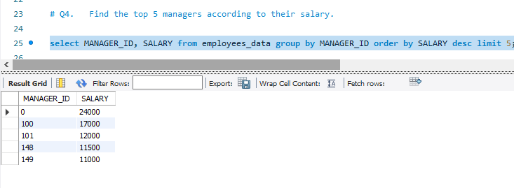
The top 5 managers according to their salary.

Slide 23
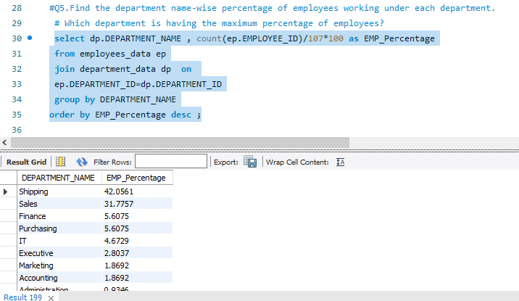
Find the department name-wise percentage of employees working under each department. Which department is having the maximum percentage of employees?

Slide 24
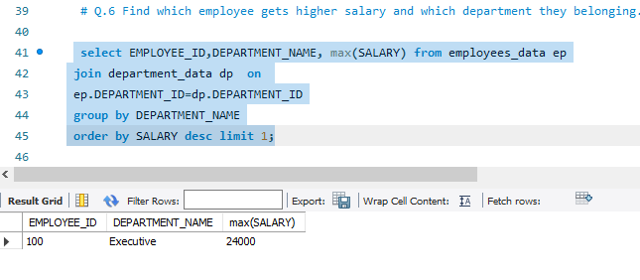
Find which employee gets higher salary and from which department.

Slide 25
Thank You
Summary​ -:
This is the presentation report on the AL DUBAI FRAGRANCE BRAND STORE
In this both report as Marketing Team and HR Team Report is present and shows all insights from data present.
This report will definitely can help the Company fro grow in the market and get better customer understanding .

